Slide 1


R installation
Advanced Institute on Hi-ASAP (2020)
Academia Sinica, Taiwan

Slide 2
R installation Steps
Step 1
Download and install the R software
https://cran.rstudio.com/
Step 2
Download and install the Rstudio
https://rstudio.com/products/rstudio/download/#download

Slide 3
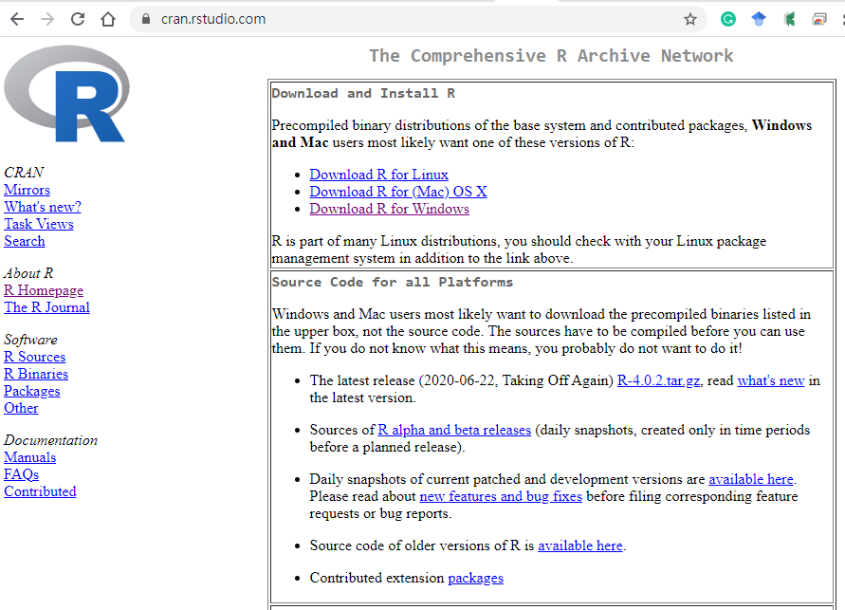
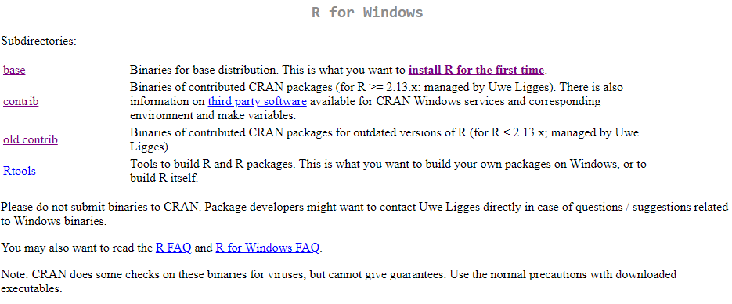
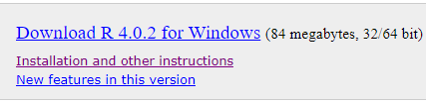
1. Download and install the R software
b. Push here for the next step.
a. Download the suitable R for your operation system (e.g., “Windows”).
c. Download the R software and install it in your system

Slide 4
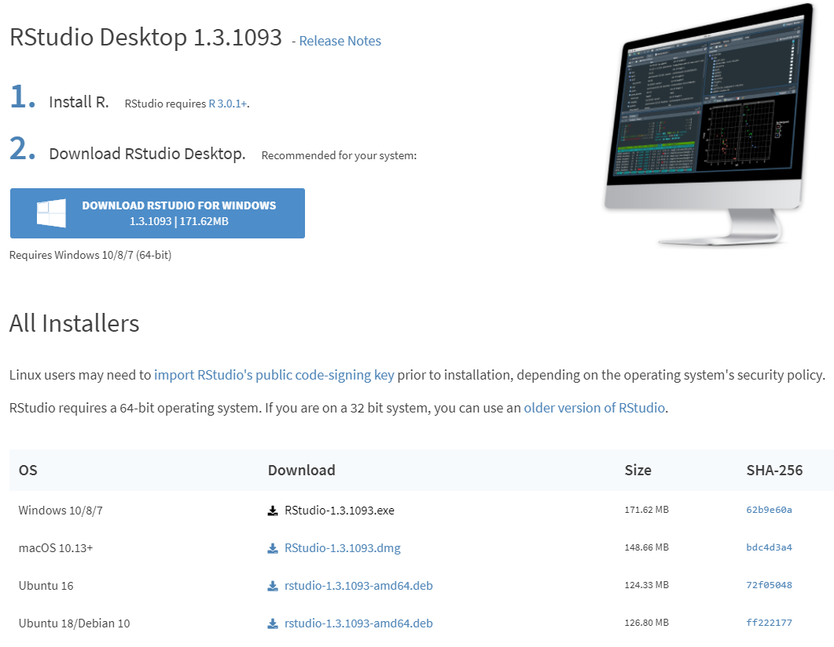
2. Download and install RStudio
a. Download the suitable RStudio for your operation system (e.g., “Windows”).
b. Download RStudio and install it in your system

Slide 5
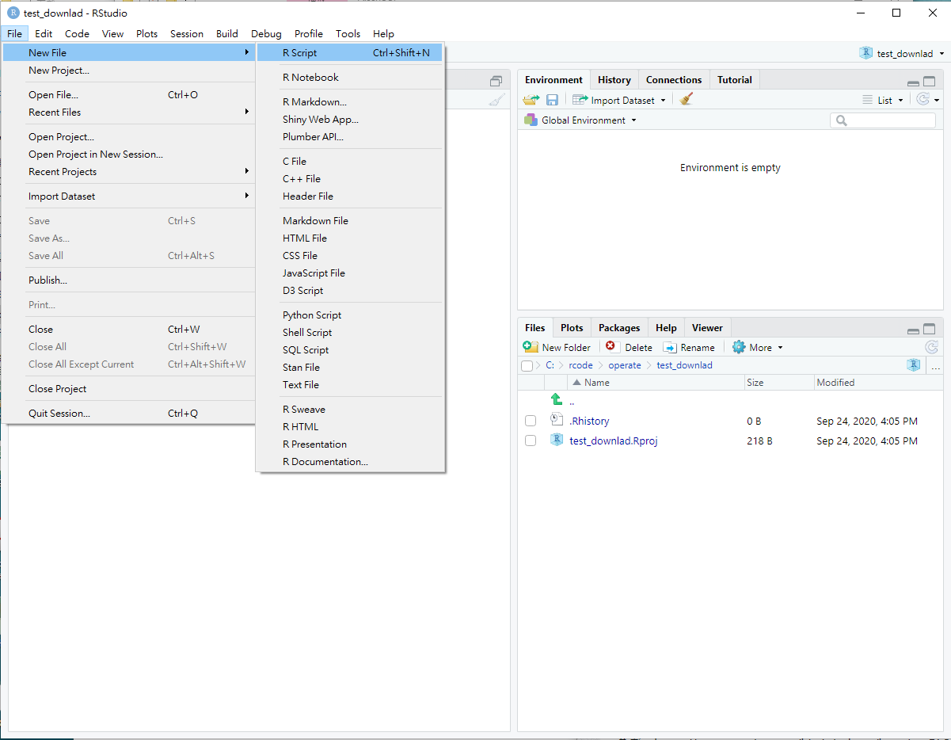
3. Start the Rstudio (1/2)
File-> New File-> R Script

Slide 6
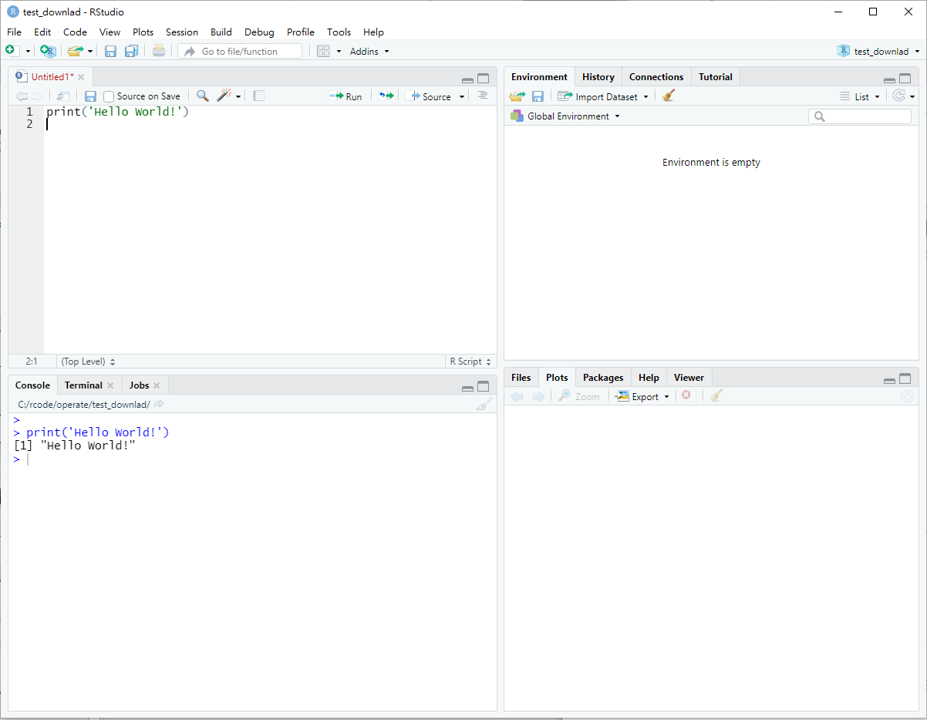
3. Start the Rstudio (2/2)
Script area
Parameter area
Output area
Plotting area

